Slide 1

Ensuring More Accurate, Generalisable, and Interpretable Machine Learning Models for Bioinformatics
Wandrille Duchemin, Van Du, Markus Müller
Swiss Institute of Bioinformatics

Slide 2
Outline
Markus Müller
Intermediate machine learning (ML)
Trees
Bagging and boosting
Classification and regression with XGBoost
Hyperparameter optimization with Hyperopt
Nested cross-validation
Interpretable machine learning with LIME and SHAP

Slide 3
Intermediate ML
Sklearn
SVM,KNN, CART, LR, RF, GridSearch
XGBoost
LightGBM
CatBoost HyperOpt
TensorFlow
PyTorch
<
<
Complexity

Slide 4
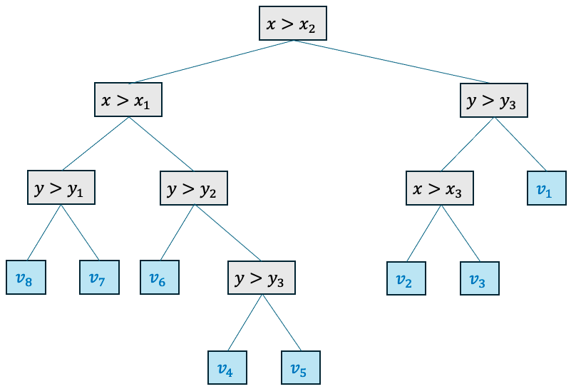

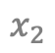
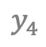
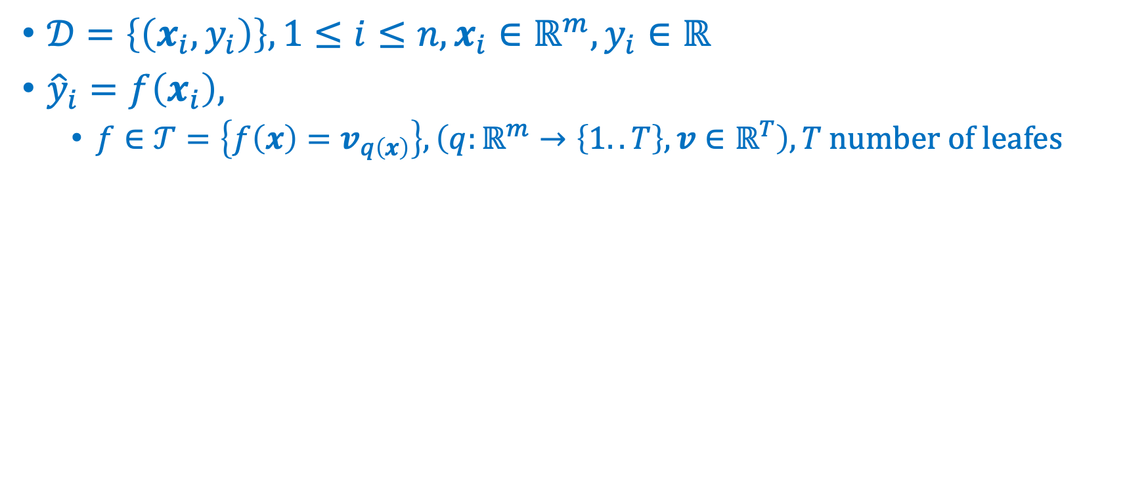
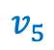
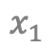
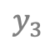

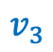
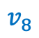
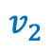
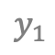
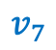
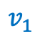
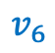
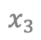
Trees
Markus Müller
$𝒟=\left\{\left(x_{i},y_{i}\right)\right\}, 1≤i≤n, x_{i}∈ℝ^{m},y_{i}∈ℝ$
${\hat{y}}_{i}=f\left(x_{i}\right),$
$f∈𝒯=\left\{f\left(x\right)=v_{q\left(x\right)}\right\}, \left(q:ℝ^{m}→\left\{1..T\right\}, v∈ℝ^{T}\right), T \text{number} \text{of} \text{leafes}$
$$v_{4}$$
$$y_{4}$$
$$v_{1}$$
$$y_{3}$$
$$v_{7}$$
$$v_{5}$$
depth
$$y_{2}$$
$$v_{2}$$
$$v_{3}$$
$$y_{1}$$
$$v_{8}$$
$$v_{6}$$
$$x_{1}$$
$$x_{2}$$
$$x_{3}$$
Leave nodes

Slide 5
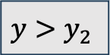
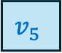
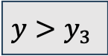
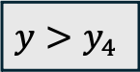
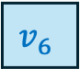
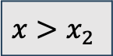
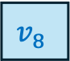
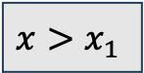
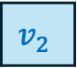
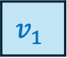
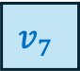
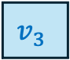
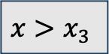
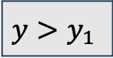
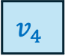
$$x>x_{2}$$
$$x>x_{1}$$
$$y>y_{3}$$
$$y>y_{1}$$
$$y>y_{2}$$
$$x>x_{3}$$
$$v_{1}$$
$$v_{8}$$
$$v_{7}$$
$$v_{6}$$
$$y>y_{4}$$
$$v_{2}$$
$$v_{3}$$
$$v_{4}$$
$$v_{5}$$

Slide 6
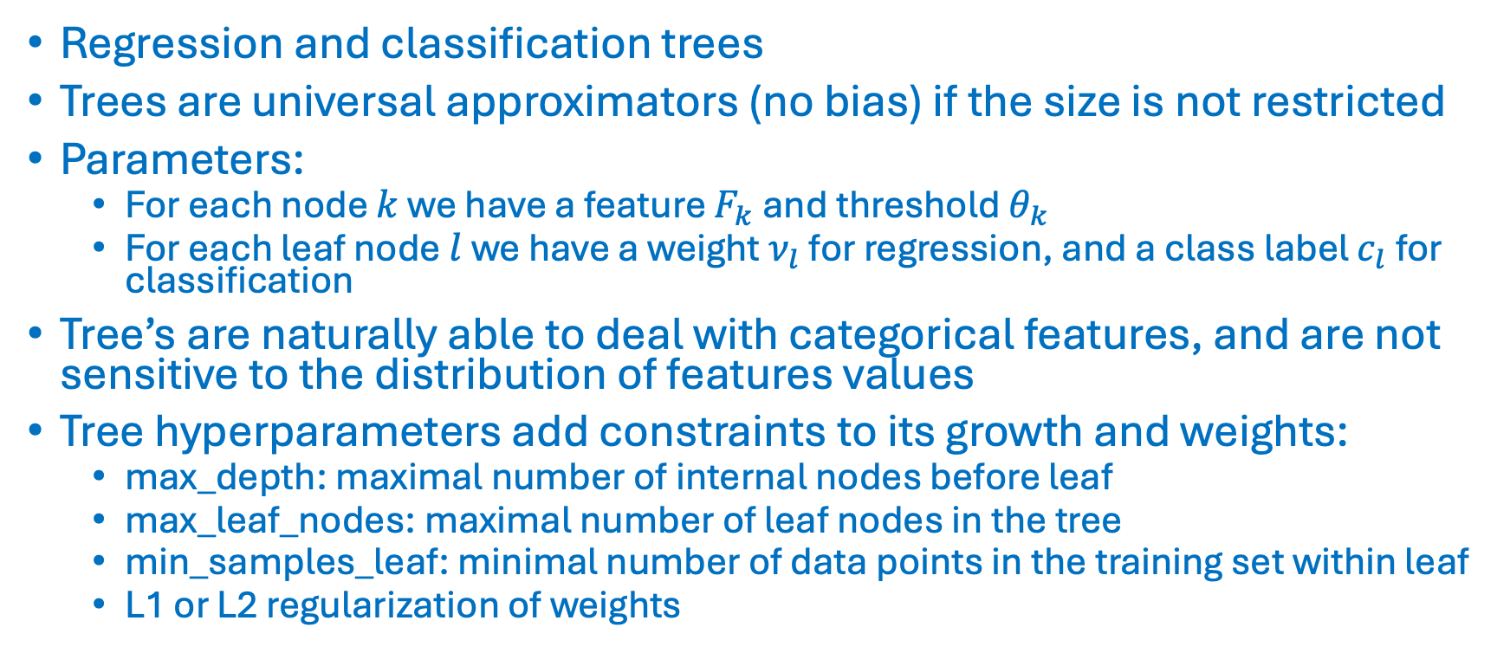
Trees
Markus Müller
Regression and classification trees
Trees are universal approximators (no bias) if the size is not restricted
Parameters:
For each node $k$ we have a feature $F_{k}$ and threshold $θ_{k}$
For each leaf node $l$ we have a weight $ν_{l}$ for regression, and a class label $c_{l}$ for classification
Tree’s are naturally able to deal with categorical features, and are not sensitive to the distribution of features values
Tree hyperparameters add constraints to its growth and weights:
max_depth: maximal number of internal nodes before leaf
max_leaf_nodes: maximal number of leaf nodes in the tree
min_samples_leaf: minimal number of data points in the training set within leaf
L1 or L2 regularization of weights

Slide 7
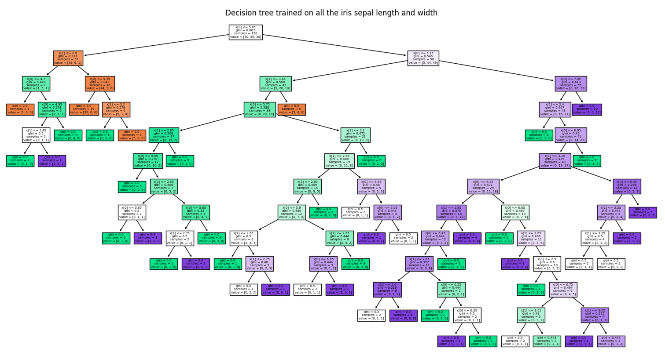
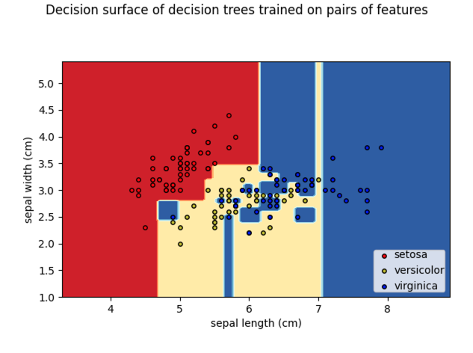
Trees
Markus Müller
Code on sklearn page !

Slide 8
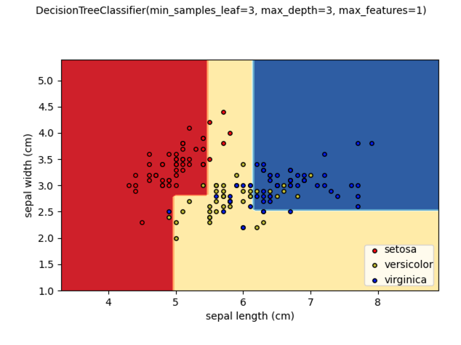
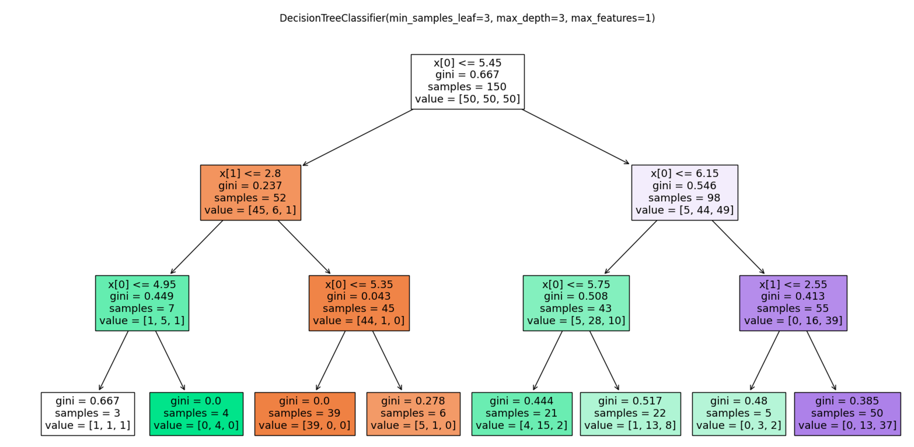
Tree hyperparameters
Markus Müller

Slide 9
Bias and Variance
Markus Müller
The bias error is an error that occurs if the assumptions in the learning algorithm do not match the data. High bias can cause an algorithm to misclassify a significant number of data items (underfitting). The bias does not disappear if you increase the size of your training data.
The variance is an error from sensitivity of the algorithms to small fluctuations in the training set. High variance may result from an algorithm modeling the random noise in the training data (overfitting). The variance becomes smaller if we increase the size of your training data.
Notes:
.

Slide 10
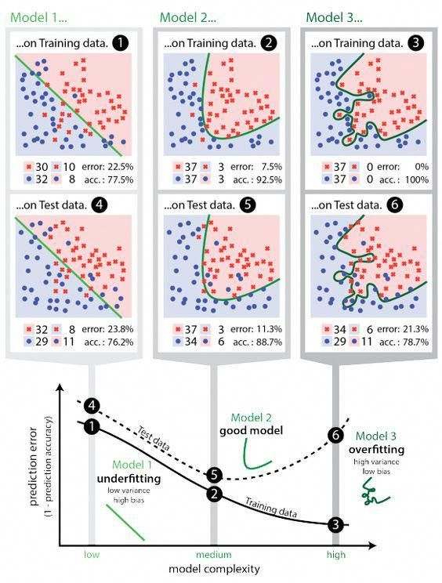
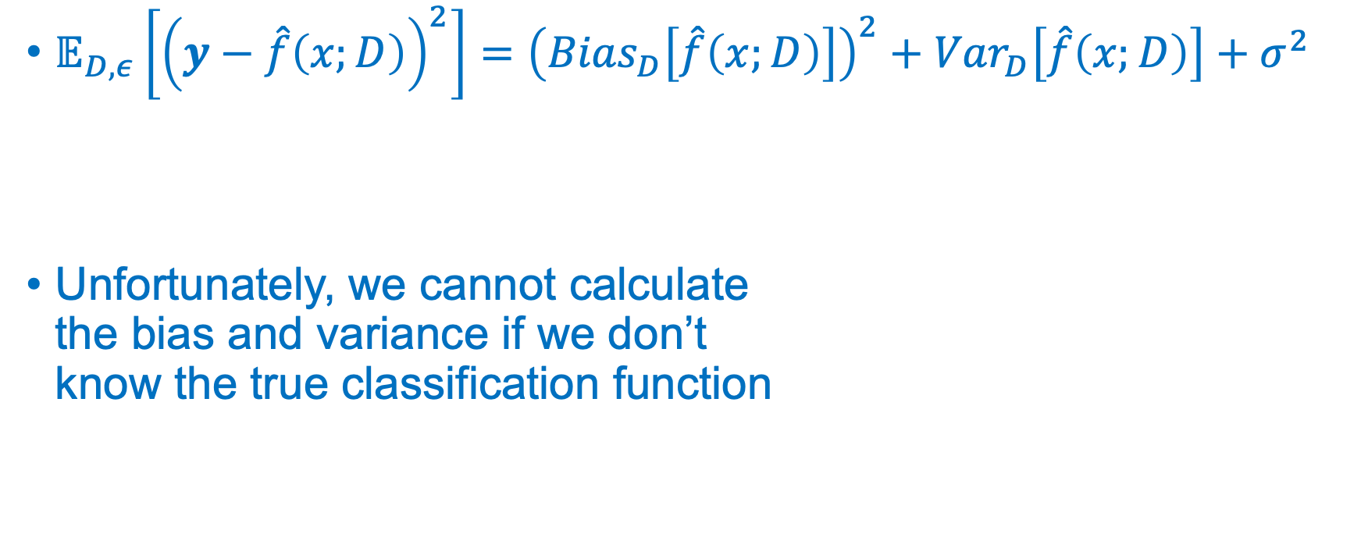
Bias and Variance
Markus Müller
$𝔼_{D,ε}\left[{\left(y−\hat{f}\left(x;D\right)\right)}^{2}\right]={\left({Bias}_{D}\left[\hat{f}\left(x;D\right)\right]\right)}^{2}+{Var}_{D}\left[\hat{f}\left(x;D\right)\right]+σ^{2}$
Unfortunately, we cannot calculate the bias and variance if we don’t know the true classification function
Prediction error
Bias error
Variance error
Data error
https://en.wikipedia.org/wiki/Bias-variance_tradeoff

Slide 11
Bias and Variance
Markus Müller
(Model prediction error)² = (Model bias error)² + (Model variance) + (Data variance)
More flexible models
Boosting
More data
Bagging
Boosting

Slide 12
Bagging and Boosting
Markus Müller
Obtain a good classifier by combining many basic, weak classifiers
Classifiers have two types of errors:
Bias (e.g. linear classifiers)
Variance (e.g. kNN, trees, unstable classifiers)
Weak classifiers are for example linear classifiers (high bias for non-linear problems) or tree classifiers (high variance without pruning)
Weak classifiers have either a high bias and/or high variance
Weak classifiers have to be better than random labels

Slide 13
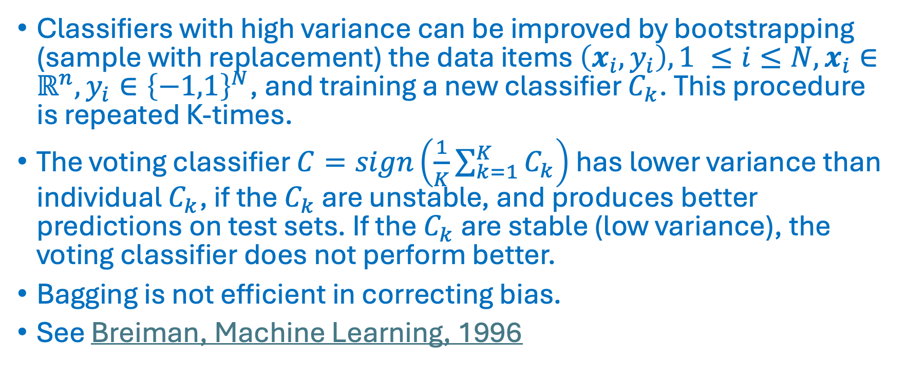
Bagging
Markus Müller
Classifiers with high variance can be improved by bootstrapping (sample with replacement) the data items $\left(x_{i},y_{i}\right), 1 ≤i≤N, x_{i}∈ℝ^{n}, y_{i}∈{\left\{−1,1\right\}}^{N}$, and training a new classifier $C_{k}$. This procedure is repeated K-times.
The voting classifier $C=sign\left(\frac{1}{K}\sum_{k=1}^{K}{C_{k}}\right)$ has lower variance than individual $C_{k}$, if the $C_{k}$ are unstable, and produces better predictions on test sets. If the $C_{k}$ are stable (low variance), the voting classifier does not perform better.
Bagging is not efficient in correcting bias.
See Breiman, Machine Learning, 1996

Slide 14
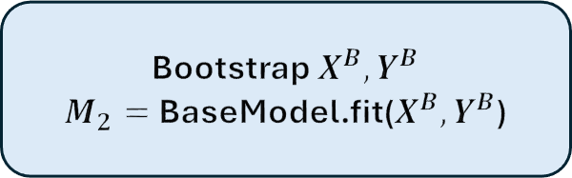
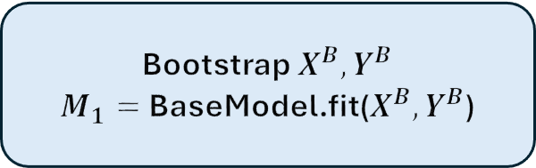
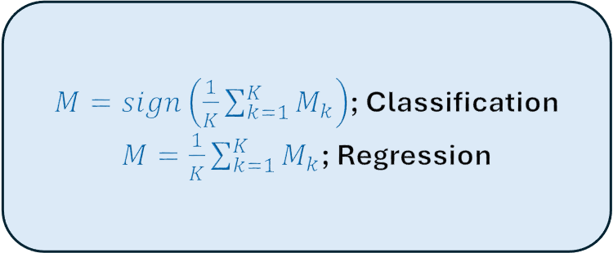
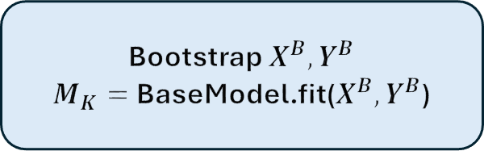
Bagging
Markus Müller
Bootstrap $X^{B},Y^{B}$
$M_{1}=$BaseModel.fit($X^{B},Y^{B}$)
$M=sign\left(\frac{1}{K}\sum_{k=1}^{K}{M_{k}}\right)$; Classification
$M=\frac{1}{K}\sum_{k=1}^{K}{M_{k}}$; Regression
Bootstrap $X^{B},Y^{B}$
$M_{2}=$BaseModel.fit($X^{B},Y^{B}$)
Bootstrap $X^{B},Y^{B}$
$M_{K}=$BaseModel.fit($X^{B},Y^{B}$)

Slide 15
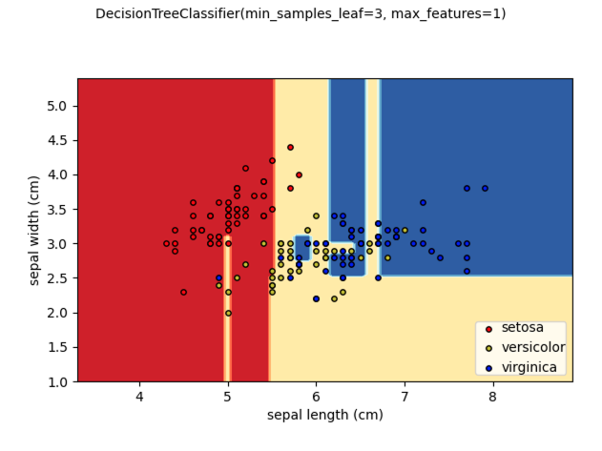
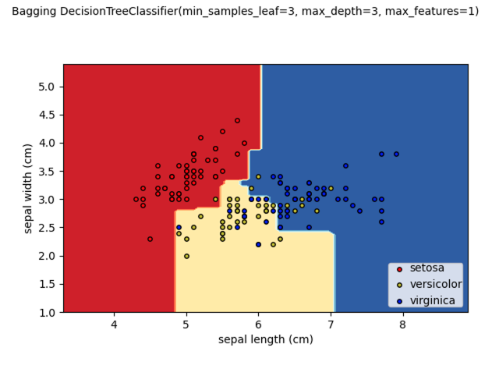
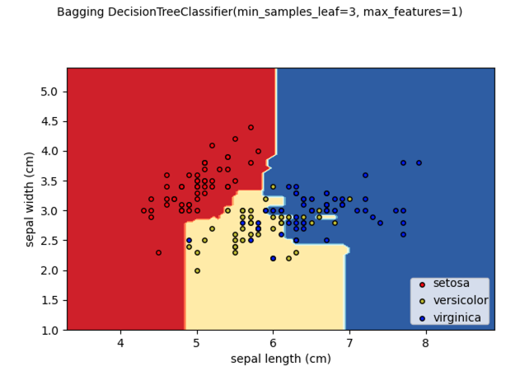
Bagging
Markus Müller
K = 1
K = 100

Slide 16
Random Forest
Markus Müller
Bootstrapped samples in bagging are similar and produce correlated base model outputs, which decreases the efficiency of bagging.
Random Forest is a bagging approach where both data items and features are sampled in order to de-correlate the trees.
A predefined number of features is sampled at each decision node in the tree. The splits in that node can only involve the selected features.
Base trees can be pruned with the max_depth, max_leaf_nodes, min_samples_leaf, … hyperparameters
Breiman, Machine Learning, 2001

Slide 17
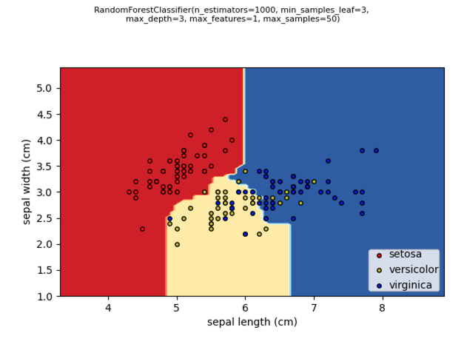
Random Forest
Markus Müller
RandomForestClassifier on sklearn

Slide 18
Boosting
Markus Müller
Bagging algorithms and RF can decrease the variance, but they cannot efficiently correct the bias of a weak classifier.
The AdaBoost algorithm (Freund & Shapire, ICML, 1996) corrects the bias too, and offers a very powerful method, which works well for many data types.
In each iteration, boosting tries to correct the error of the previous iteration by increasing the weights of the misclassified data items.
The current classifier focuses on those misclassified data points and is added to the previous classifiers.

Slide 19
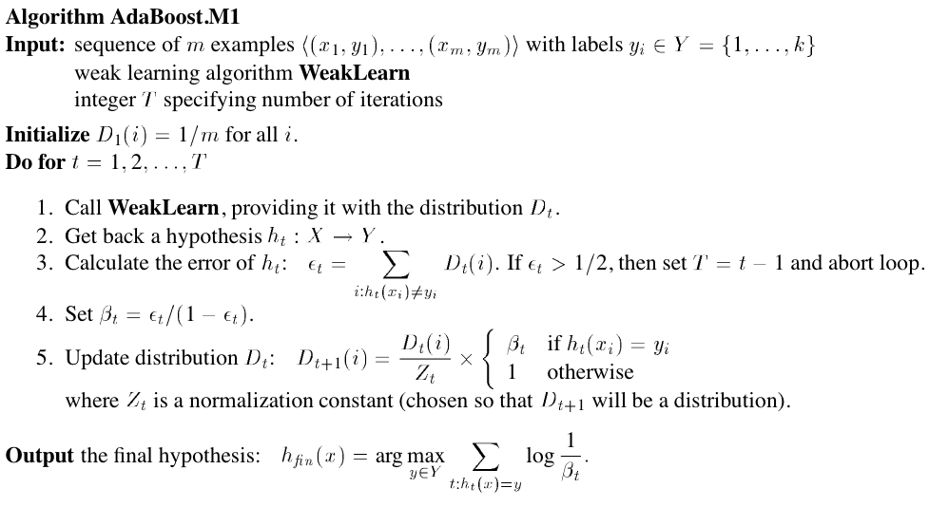
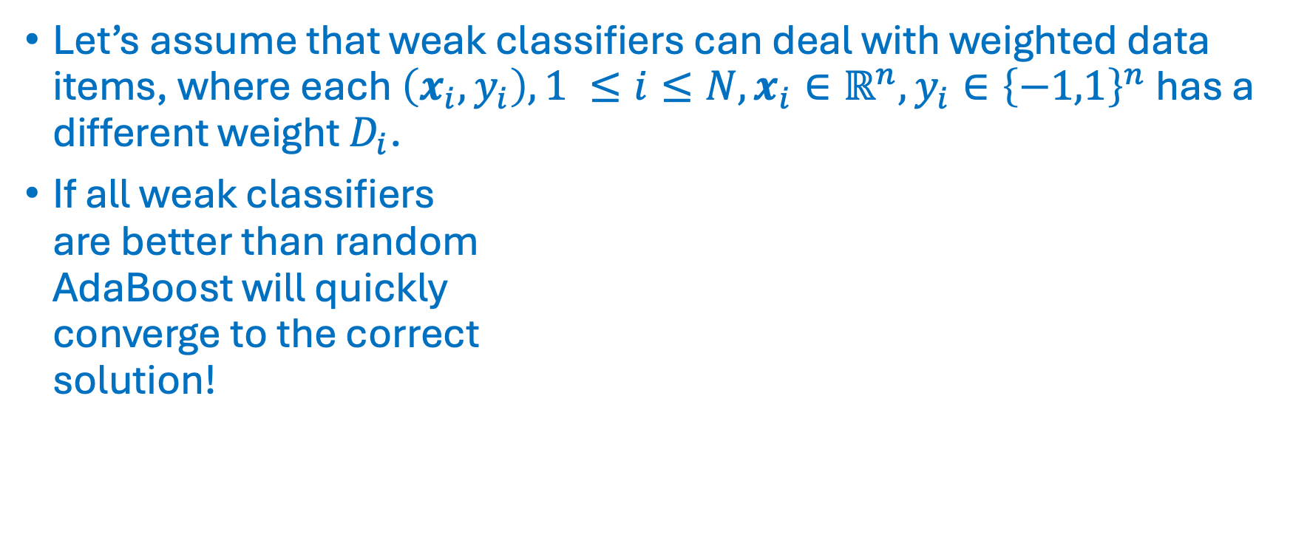
AdaBoost
Markus Müller
Let’s assume that weak classifiers can deal with weighted data items, where each $\left(x_{i},y_{i}\right), 1 ≤i≤N, x_{i}∈ℝ^{n}, y_{i}∈{\left\{−1,1\right\}}^{n}$ has a different weight $D_{i}$.
If all weak classifiers are better than random AdaBoost will quickly converge to the correct solution!
Notes:
AdaBoost.M1 for base classifier that outputs one class label
AdaBoost.M2 for base classifier that outputs class probabilities

Slide 20
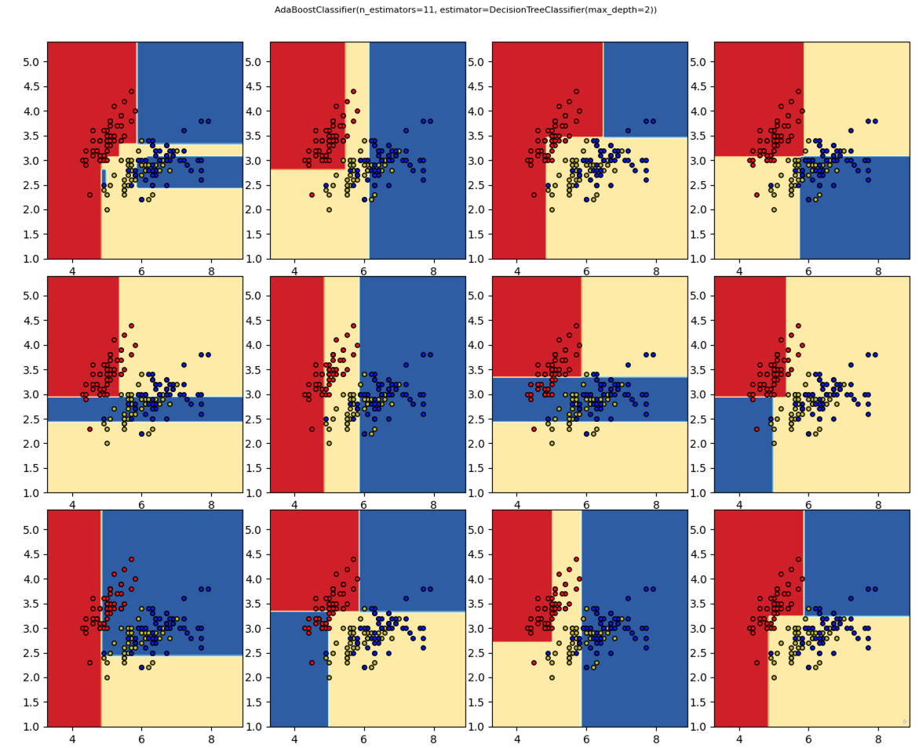
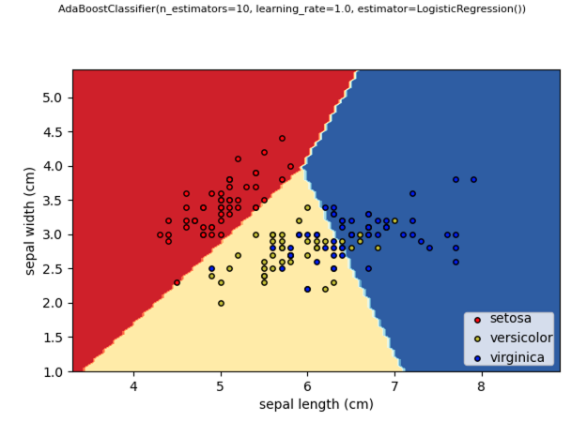

AdaBoost
Markus Müller

Slide 21
Gradient Boosting
Markus Müller
Mason et al. (Mason et al., NIPS, 1999) showed that AdaBoost is a special case of the Gradient Boosting framework.
In the gradient boosting framework, you choose a cost function and select a weak classifier, which minimizes the gradient of the cost function (in function space)
Mason et al. showed that some cost functions can perform better than AdaBoost, which is more prone to overfitting.
For a thorough comparison of bagging and boosting methods see Dietterich, Machine Learning, 2000.

Slide 22
XGBoost: a scalable and flexible gradient boosting system
Markus Müller
Extreme gradient boosting system
Introduced by Chen & Guestrin in 2016 (Chen & Guestrin, KDD 16, 2016)
Efficient implementation for tree and linear boosting for regression, classification, and ranking.
Support for parallelization, cluster computing, and GPU.
Very flexible and configurable API.
Callbacks, checkpoints, early stopping, dropout (dart), incremental learning, configurable sampling, regularization, many losses and metrics, choice of algorithm, …
XGBoost provides robust and complementary results when compared to neural network models on tabular data

Slide 23
XGBoost Framework
Markus Müller
Exact greedy (slower) and approximate (faster) algorithms
Deal with missing values (sparsity aware)
Include feature interaction constraints
Include monotonicity constraints
Include regularization (shrinkage, sampling, penalties, dropout)
Callbacks, early stopping
Update existing model with new data
Parallel on multiple CPUs, support for Spark distributed computing
GPU support
Out-of-core computing (data larger than memory)
Multiple outputs
Since 2.0: optimize histo size, learning to rank, quantile regression, federated learning

Slide 24

XGBoost
Markus Müller
${\hat{y}}_{i}\left(x_{i}\right)=\sum_{k=1}^{K}{f_{k}\left(x_{i}\right); f_{k}\left(x_{i}\right)=}$ base tree classifier
Boosting algo: fit tree to error $y_{i}−{\hat{y}}_{i}^{t−1}$of previous iteration:
$$ℒ^{t}\left({\hat{y}}_{i}^{t−1},f_{t}\right)=\sum_{i=1}^{N}{l\left(y_{i},{\hat{y}}_{i}^{t−1}+f_{t}\left(x_{i}\right)\right)+}Ω\left(f_{t}\right)$$
loss function $l\left({\hat{y}}_{i},y_{i}\right)$ (e.g. square loss $l\left({\hat{y}}_{i},y_{i}\right)=\frac{1}{2}{\left({\hat{y}}_{i}−y_{i}\right)}^{2}$)
regularization term $Ω\left(f\right)=γT+\frac{1}{2}λ\sum_{i=1}^{T}{v_{i}^{2}}$
$T$: number of leaves; $v$: values at leaves

Slide 25


XGBoost
Markus Müller
Gradient boosting:
$ℒ^{t}\left({\hat{y}}_{i}^{t−1},f_{t}\right)≈\sum_{i=1}^{N}{\left\{l\left(y_{i},{\hat{y}}_{i}^{t−1}\right)+g_{i}f_{t}\left(x_{i}\right)+\frac{1}{2}h_{i}f_{t}^{2}\left(x_{i}\right)\right\}+}Ω\left(f_{t}\right)$ $=\sum_{i=1}^{N}{l\left(y_{i},{\hat{y}}_{i}^{t−1}\right)+\sum_{i=1}^{N}{\left\{g_{i}f_{t}\left(x_{i}\right)+\frac{1}{2}h_{i}f_{t}^{2}\left(x_{i}\right)\right\}}+}Ω\left(f_{t}\right)$
$g_{i}=\frac{∂}{∂{\hat{y}}_{i}^{t−1}}l\left(y_{i},{\hat{y}}_{i}^{t−1}\right)$; $h_{i}=\frac{∂^{2}}{∂^{2}{\hat{y}}_{i}^{t−1}}l\left(y_{i},{\hat{y}}_{i}^{t−1}\right)$
$${\tilde{ℒ}}^{t}\left({{\hat{y}}_{i}^{t−1},f}_{t}\right)$$

Slide 26


XGBoost - square loss
Markus Müller
$l\left(y,\hat{y}\right)={\frac{1}{2}\left(y−\hat{y}\right)}^{2}$
Gradient boosting: $g_{i}=\left({\hat{y}}_{i}^{t−1}−y_{i}\right);$ $h_{i}=1$
${\tilde{ℒ}}^{t}\left({{\hat{y}}_{i}^{t−1},f}_{t}\right)=\sum_{i=1}^{N}{\left\{\left({\hat{y}}_{i}^{t−1}−y_{i}\right) f_{t}\left(x_{i}\right)+ {\frac{1}{2}f}_{t}^{2}\left(x_{i}\right)\right\}+Ω\left(f_{t}\right)}$
$$\begin{matrix}\left({\hat{y}}_{i}^{t−1}−y_{i}\right)>0:f_{t}\left(x_{i}\right)<0 \\ \left({\hat{y}}_{i}^{t−1}−y_{i}\right) \sim 0:f_{t}\left(x_{i}\right) \sim 0 \\ \left({\hat{y}}_{i}^{t−1}−y_{i}\right)<0:f_{t}\left(x_{i}\right)>0\end{matrix}$$
Regularization term

Slide 27



XGBoost - n$egative log likelyhood$
Markus Müller
$l\left(y,f\left(x\right)\right)=−\left[y\log{\hat{p}}+\left(y−1\right)\log\left(1−\hat{p}\right)\right]; \hat{p}=\frac{1}{1+e^{−f\left(x\right)}}$
Gradient boosting: $g_{i}=\left({\hat{p}}_{i}^{ }−y_{i}\right);$ $h_{i}={\hat{p}}_{i}^{ }\left({1−\hat{p}}_{i}^{ }\right)$
${\tilde{ℒ}}^{t}\left({\hat{y}}_{i}^{t−1},f_{t}\right)=\sum_{i=1}^{N}{\left\{\left({\hat{p}}_{i}^{t−1}−y_{i}\right) f_{t}\left(x_{i}\right)+ {\frac{1}{2}{\hat{p}}_{i}^{t−1}\left({1−{\hat{p}}_{i}^{t−1}}_{ }^{ }\right)f}_{t}^{2}\left(x_{i}\right)\right\}+Ω\left(f_{t}\right)}$
$$\begin{matrix}\left({\hat{p}}_{i}^{t−1}−y_{i}\right)>0:f_{t}\left(x_{i}\right)<0 \\ \left({\hat{p}}_{i}^{t−1}−y_{i}\right) \sim 0:f_{t}\left(x_{i}\right) \sim 0 \\ \left({\hat{p}}_{i}^{t−1}−y_{i}\right)<0:f_{t}\left(x_{i}\right)>0\end{matrix}$$
Regularization term

Slide 28

XGBoost
Markus Müller
Initialize $f_{0}\left(x\right)=\underset{v,Tree}{argmin}{ℒ\left({\hat{y}}_{i}^{0},f\right)}$
$\text{for} t=1..K$
Sample columns of $X$ and/or rows of $X, y$
$f_{t}\left(x\right)=\underset{v,Tree}{argmin}{{\tilde{ℒ}}^{t}\left({\hat{y}}_{i}^{t−1},f_{t}\right)}$ ${\hat{y}}_{i}^{t}\left(x_{i}\right)={\hat{y}}_{i}^{t−1}\left(x_{i}\right)+η$ $f_{t}\left(x\right)$, shrinkage parameter eta: $0<η≤1$
Output ${\hat{y}}_{i}^{K}\left(x_{i}\right)$

Slide 29






XGBoost

Slide 30



XGBoost
Markus Müller
How does XGBoost find the optimal tree?
Let’s assume the tree $f_{t}$ is known appart from the leaf values $v$
Define $I_{j}=\left\{i | leaf\left(x_{i}\right)=j\right\}$, i.e. all points $x_{i}$ from the training set that belong to leaf $j$
Then the optimal leaf values are:
$v_{j}=−\frac{\sum_{i∈I_{j}}{g_{i}}}{\sum_{i∈I_{j}}{h_{i}+λ}}$
The change in the loss function introduced by a split can then be calculated: $ℒ_{split}=\frac{1}{2}\left[\frac{{\left(\sum_{i∈I_{L}}{g_{i}}\right)}^{2}}{\sum_{i∈I_{L}}{h_{i}+λ}}+\frac{{\left(\sum_{i∈I_{R}}{g_{i}}\right)}^{2}}{\sum_{i∈R}{h_{i}+λ}}−\frac{{\left(\sum_{i∈I_{ }}{g_{i}}\right)}^{2}}{\sum_{i∈I_{ }}{h_{i}+λ}}\right]−γ$
Finding $f_{t}$ that minimizes ${\tilde{ℒ}}^{t}\left(f_{t}\right)$ is difficult. The greedy gbtree algorithm finds the split $I=I_{L}⋃$ $I_{R}$ that maximizes $ℒ_{split}$.
$$square loss: v=−\frac{\sum_{i∈I}{\left({\hat{y}}_{i}^{ }−y_{i}\right)}}{\left|I\right|+λ}$$
$$ℒ_{split}=\frac{1}{2}\left[\frac{{\left(\sum_{i∈I_{L}}{\left({\hat{y}}_{i}^{ }−y_{i}\right)}\right)}^{2}}{\left|I\right|+λ}+\frac{{\left(\sum_{i∈I_{R}}{\left({\hat{y}}_{i}^{ }−y_{i}\right)}\right)}^{2}}{\left|I\right|+λ}−\frac{{\left(\sum_{i∈I_{ }}{\left({\hat{y}}_{i}^{ }−y_{i}\right)}\right)}^{2}}{\left|I\right|+λ}\right]−γ$$

Slide 31

XGBoost
Markus Müller
If the maximal score is larger than $γ$, we have a valid split
Notes:
Exact algo

Slide 32























XGBoost
$$x<8.5$$
$$I=\left\{1,2,3,4,5\right\}$$
$$ν=5.10$$
$$ν=9.31$$
$$I=\left\{1,2,3,4\right\}$$
$$I=\left\{5\right\}$$
$$η=0.8; λ=1;γ=10$$
$$v=−\frac{\sum_{i∈I}{\left({\hat{y}}_{i}^{ }−y_{i}\right)}}{\left|I\right|+λ}$$
$$ℒ_{split}=\frac{1}{2}\left[\frac{{\left(\sum_{i∈I_{L}}{\left({\hat{y}}_{i}^{ }−y_{i}\right)}\right)}^{2}}{\left|I\right|+λ}+\frac{{\left(\sum_{i∈I_{R}}{\left({\hat{y}}_{i}^{ }−y_{i}\right)}\right)}^{2}}{\left|I\right|+λ}−\frac{{\left(\sum_{i∈I_{ }}{\left({\hat{y}}_{i}^{ }−y_{i}\right)}\right)}^{2}}{\left|I\right|+λ}\right]−γ$$

Slide 33

XGBoost
Markus Müller
$$ℒ_{split}$$
$$ℒ_{split}$$

Slide 34

XGBoost – Approximate algo and missing values
Instead of testing each value of a numeric feature as a potential threshold, XGBoost has an approximate histogram-based algorithm, which only allows splits at certain percentiles.
Each interval contains datapoints $x_{i}$ with a similar sum of hessian $h_{i}$
In case of missing values, XGBoost calculates a default direction for each node. The default direction gives the largest gain $ℒ_{split}$ if all missing values are assigned to this direction.

Slide 35

XGBoost – approximate histogram splits

Slide 36


XGBoost – missing values

Slide 37

XGBoost Hyperparameters
Markus Müller
booster: base model (gbtree, dart or gblinear)
device: GPU or CPU
eta: step size shrinkage ($η$)
gamma: minimum loss reduction required to make a further partition on a leaf node ($γ$)
max_depth: maximum depth of a tree
min_child_weight: minimum sum of instance weight needed in a child
subsample: subsample ratio of the training instances
colsample_bytree, colsample_bylevel, colsample_bynode: parameters for subsampling of columns
lambda: L2 regularization term on weights
tree_method: The tree construction algorithm
scale_pos_weight: useful for unbalanced classes
process_type: used to update existing model
max_leaves: maximum number of leaves
monotone_constraints: constraint of variable monotonicity
interaction_constraints: constraints for interaction representing permitted interactions
objective: loss function
eval_metric: evaluation metrics for validation data
max_cat_to_onehot: how to deal with categorical features

Slide 38

XGBoost +/-
Markus Müller
When to use XGBoost
Classification and regression problems
Categorical variables
Missing values
Tabular data with heterogeneous features
Very flexible and comprehensive API
Applicable to large data
…
When not to use XGBoost
$n>N$, i.e. more features than observations
Regression tasks, where output needs to be continuous
Extrapolation tasks
For image and language processing NN are preferred
Other excellent gradient boosting tools are LightGBM, CatBoost,..
Notes:
LightGBM: Microsoft
CatBoost: Yandex

Slide 39

Hyperparameters
Markus Müller
In the classification task, we would like to predict the outcome $y$ from the features $X$.
We choose a classifier $𝒞_{φ}$ with hyper parameters $φ$ and internal parameters $θ$.
Hyper parameters (e.g $k$ in $k−NN$, kernel in $SVM$, learning rate in $LR$) have to be specified by the user or learned in CV loop outside the classifier.
The internal parameters $θ$ are learned by the classifier (e.g. the coefficients in $LR$, or support vector coefficients in $SVM$).
The classifier learns those internal parameters $θ$ that are able to predict $y$ from the features $X$ with the lowest error: $θ=\underset{θ}{argmin}{ℒ\left(𝒞_{φ}.\text{predict}\left(X,θ\right),y\right)}$ where the loss function $ℒ$ measures the error between predicted ($𝒞_{φ}.\text{predict}\left(X,θ\right)$) and known ($y$) outcomes.

Slide 40
Hyperparameter optimization
Markus Müller
ML models have internal parameters, which are learned by the training algorithm, and hyperparameters, which have to be set before training.
Both internal - and hyperparameters have a strong impact on the performance of the ML model.
There is a tradeoff between CPU/GPU cycles spent on hyperparameter optimization and training. Allocating more cycles for hyperparameter optimization can be more rewarding.
Hyperparameter optimization is implemented as an outer loop over the CV loop

Slide 41

Hyperparameter optimization and CV
Markus Müller
Hyperparameter space $Φ$
Dataset $X$, Labels $y$
Number of iterations $M$
Number of CV folds $F$
$S_{max}=−∞$, $φ_{max}=None$
for $i=1,..,M$ :
$$φ=choose\left(Φ\right)$$
for $j=1,..,F$ :
$X_{train},$ $X_{test},y_{train}, y_{test}=split\left(X,j\right)$
${C_{φ,θ}=𝒞}_{φ}$.train$\left(X_{train}\right)$
$S_{j}=S\left(C_{φ,θ}.\text{predict}\left(X_{test}\right),y_{test}\right)$
$\overline{S}=\frac{1}{F}\sum_{j=1}^{F}{S_{j}}$
if $\overline{S}>S_{max}$: $S_{max}=\overline{S}$, $φ_{max}=$ $φ$
Hyperparameter loop
CV loop

Slide 42
Hyperparameter optimization
Markus Müller
Hyperparameters have grid or tree-structured configuration spaces of discrete, ordinal, and continuous variables.
Complete tree or grid searches are often too slow for large search spaces:
Random searches
Gaussian process (GP) and tree-parzen estimator (TPE) algorithms suggest which parameter combination to test in the next step based on previous results.
Hyperopt (Bergstra et al. Neurips 2011) implements both strategies. It is open-source and available on https://github.com/hyperopt/hyperopt.
Other tools are Hypermax (tree parzen estimator), Scikit-Optimizer (skopt) (Bayesian), Spearmint (Bayesian), Hyperband (fast random armed bandit), Optuna (dynamic search space, pruning, easy API), Optunity (grid-, random-, evolutionary-, swarm-, Bayesian search)

Slide 43
Hyperopt
Markus Müller
Random algorithms find optimal solutions faster and more accurately than grid searches (Bergstra & Bengio, J. Mach. Learn. Res., 2012)
Therefore Hyperopt implements a random search algorithm.
Hyperopt also offers two other model-based search algorithms:
Gaussian process approach (GP) (not implemented in python)
Tree-structured Parzen window approach (TPE)
Hyperopt supports nested parameter spaces
Hyperopt supports warm start using previous results

Slide 44


Hyperopt’s model-based algorithm
Markus Müller
$$S\left(x, M\right)={EI}_{y^{∗}}\left(x\right)=\int_{−∞}^{+∞}{\max_{ }\left(y^{∗}−y,0\right)p_{M}\left(y | x\right)dy}$$
$$EI: \text{Expected} \text{improvement} \text{for} \text{score} \text{values} x$$

Slide 45





Hyperopt’s GP algorithm
Markus Müller
$$S\left(x, M\right)={EI}_{y^{∗}}\left(x\right)=\int_{−∞}^{+∞}{\max_{ }\left(y^{∗}−y,0\right)p_{M}\left(y | x\right)dy};y^{∗}=\min_{ }\left\{f\left(x_{i}\right), 1≤i≤n\right\}$$
$p_{M}\left(y | x\right)$: estimated by gaussian process (GP)
The GP algorithms will give a large EI value for hyperscore
values $x$ if a large probability mass is below $y^{∗}$. This is the
case for
values of $x$ close to the minimum
values of $x$ in not yet explored regions, which have a large uncertainty
$$y^{∗}$$

Slide 46










Hyperopt’s TPE algorithm
Markus Müller
$$S\left(x, M\right)={EI}_{y^{∗}}\left(x\right)=\int_{−∞}^{+∞}{\max_{ }\left(y^{∗}−y,0\right)p_{M}\left(y | x\right)dy}= \\ \int_{−∞}^{y^{∗}}{\underset{ }{\left(y^{∗}−y\right)}\frac{p_{M}\left(x | y\right)p\left(y\right)}{p\left(x\right)}{dy}∝{\left(γ+\frac{g\left(x\right)}{l\left(x\right)}\left(1−γ\right)\right)}^{−1} }$$
g$\left(x\right)$
$$l\left(x\right)$$
$$y^{∗}$$
g$\left(x\right)$
$$l\left(x\right)$$
The TPE algorithm will choose hyperscores with large $l\left(x\right)$ and small $g\left(x\right)$.
TPE: Tree structured Parzen estimator
$$y^{∗}=γ−\text{quantile}:p\left(y<y^{∗}\right)=γ$$

Slide 47

Hyperopt Iterations
Markus Müller
Müller et al. Immunity, 2024

Slide 48

Nested Cross-Validation (CV)
Markus Müller
Issues that may arise with CV:
Let’s assume you perform a hyperparameter optimization for a classifier with CV. In each iteration, you keep the maximal score $S_{max}$. Even if all scores are drawn from Null distribution, this will lead to a final score $S_{max}$that is significantly higher than the expected score.
We strongly discourage ML practitioners to perform any operation that uses information from test or validation data (such as feature selection, MV imputation, normalization) for data preprocessing pefore the CV loop. In the CV loop, this data leakage will lead to $S_{max}$ that are too high, especially for small sample sizes.
Solution: always calculate your score $S$ on a part of the data that was not used for proprocessing.

Slide 49

Nested Cross-Validation (CV)
Markus Müller
Valabas et al. PLoS, 2019

Slide 50


Nested Cross-Validation (CV)
Markus Müller
Simple CV
Nested CV
Varma & Simon, BMC Bioinformatics, 2006

Slide 51


Nested Cross-Validation (CV)
Markus Müller
Valabas et al. PLoS, 2019

Slide 52
Interpretable Machine Learning (IML)
Markus Müller
ML tools are optimized for metrics such as accuracy, which can lead to accurate, but wrong models.
Many models are black boxes, i.e. they do not reveal in a human readable form how they make their decision.
In order to understand a model, we need to approximate the model’s decision with a simple human readable model.
If this simple approximation corresponds to human intuition and is faithful (i.e. truly reflects the underlying ML model), we can better trust the ML model.

Slide 53


Interpretable Machine Learning (IML)
Markus Müller
Ribeiro et al., ACM SIGKDD, 2016

Slide 54
Interpretable Machine Learning (IML)
Markus Müller
What does «interpretable» mean in the context of ML?
A good IML model has to deliver an interpretation of an ML model prediction that is human-readable, plausible, and faithful.
Plausible: how convincing is the interpretation to humans
Faithful:
the IML interpretation approximates the true reasoning process of the ML model
the interpretation should not change drastically if different datasets are used for the ML model training or prediction.
it should be similar for different ML models, which make similar predictions.
https://christophm.github.io/interpretable-ml-book/
Chen et al, Nature Methods, 2024

Slide 55
Interpretable Machine Learning (IML)
Markus Müller
Some ML methods such as linear regression, logistic regression, decision trees, GLM’s, GAM’s are interpretable by humans, i.e. they tell you explicitly how features contribute to the outcome.
Other ML methods (such as NN, SVM, and boosting methods) can perform very well but are not interpretable by humans.
However, understanding prediction by ML model is important to trust the model, study biases, and eventually improve it.
Either, these black-box methods are customized for interpretability or one has to use post hoc tools such as Shap, Lime, DeepLIFT, ...
These ad-hoc tools provide human interpretable simple models, which approximate the underlying complex ML model.
Such simple models may be feature importance scores (linear approximation), simple trees, or decision rules.

Slide 56

Interpretable Machine Learning (IML)
Markus Müller
Chen et al, Nature Methods, 2024

Slide 57
Interpretable Machine Learning (IML)
Markus Müller
However, there is no consensus, which IML method works best (Krishna et al, Mach. Learning Research, 2024; Agarwal et al. NeurIPS, 2022)
Need to evaluate the IML interpretation scores by these criteria:
Plausibility: is the interpretation plausible? Do the IML interpretations agree with prior knowledge?
Faithfulness: Does it give the correct answers on synthetic datasets (https://open-xai.github.io/)? Do they reflect the model’s reasoning process?
Stability: are the scores robust for different hyperparameter choices for the underlying model? Are they robust with regard to data sampling and different datasets? Do different IML methods give similar results?

Slide 58
IML Guidelines
Markus Müller
Use several IML methods and compare the results
Use several datasets if possible, or randomly sample from your data, to show that your results are robust.
Use different hyperparameter choices for the underlying model. Use more than one model.
Evaluate the plausibility and faithfulness of the IML interpretation:
Do they agree with prior or expert knowledge?
Do they represent the model’s reasoning process?
Avoid cherry-picking nice examples, but always report full results.
Chen et al, Nature Methods, 2024

Slide 59

IML
Markus Müller
Local interpretation:
An interpretation is calculated for a single data vector $x$.
A local interpretation tells you, how a specific data vector $x$ was predicted by the ML model. It tells you which features are predominantly involved in the prediction.
Global interpretation:
An interpretation is calculated on a whole data set $\left\{x_{k}\right\}, k=1,..,N$
The global interpretation tells you, which features are predominantly involved in the prediction of a whole dataset.
A global interpretation can be obtained by averaging over local interpretations.

Slide 60
LIME
Markus Müller
LIME: Local Interpretable Model-Agnostic Explanations
Approximates any ML model by a simple local model
Provides control over the complexity of the local model
Provides global interpretation of the ML model
https://github.com/marcotcr/lime
Watch: https://www.youtube.com/watch?v=hUnRCxnydCc
Ribeiro et al., ACM SIGKDD, 2016

Slide 61

LIME
Markus Müller
Let’s assume we have a trained ML model, which predicts the output $f\left(x\right)$ of a vector $x=\left(x_{1},..,x_{n}\right)∈ℝ^{n}$
Let $x′∈{\left\{0,1\right\}}^{n^{′}}$be an interpretable representation of $x$
For a feature vector $x∈ℝ^{n}$, $x^{′}=\left(0,0,1,…,1, 0\right)$ $∈{\left\{0,1\right\}}^{n}$ means features with a 1 (0) are included (excluded)
For a text input, $x^{′}=\left(0,0,1,…,1, 0\right)$ $∈{\left\{0,1\right\}}^{n^{′}}$ means that the first two words in a dictionary are absent in the text, the third one is present, …
For an image input $x∈ℝ^{n}$, $x^{′}=\left(0,0,1,…,1, 0\right)$ $∈{\left\{0,1\right\}}^{n^{′}}$may indicate the presence/absence of a continuous image region with similar pixel properties (super-pixel)

Slide 62





LIME
Markus Müller
Text
“The dog plays with another dog in the park.”
Feature vector
Image
Feature | $$x$$ | $$x^{′}$$
another | 1 | 1
car | 0 | 0
cat | 0 | 0
dog | 2 | 1
mouse | 0 | 0
park | 1 | 1
play | 1 | 1
Feature | $$x$$ | $$x^{′}$$
sneeze | yes | 1
weight | 60 | 0
headache | yes | 1
no fatigue | -1 | 1
age | 55 | 0
$$x=$$
$$x^{′}=\left(0,0,0,..,1,1,..0\right)$$

Slide 63

LIME
Markus Müller
Let $g∈G$ be our simple approximation model of a certain class $G$ (linear model, Tree, ..).
$g:x′⟼g\left(x′\right)∈ℝ$. E.g. $g\left(x′\right)=$ $w_{g}∙$ $x′$
$Ω\left(g\right)$: enforces contraint on complexity of $g$. E.g. $Ω\left(g\right):{\left\|w_{g}\right\|}_{0}≤K$ for linear $g$, or $depth\left(g\right)$ $≤K$ for a tree.
$π_{x}\left(z\right)$: distance measure between input vectors $x$and $z$. E.g. $π_{x}\left(z\right)=exp\left({−D\left(x,z\right)}/{σ^{2}}\right)$
Masking: $z\left(x, bg,x^{′}\right)≡\left\{\begin{matrix}x_{i} \text{for} {x′}_{i}=1 \\ {bg}_{i} \text{for} {x′}_{i}=0\end{matrix}\right.$
$ℒ\left(f,g,π_{x}\right)$: measure how faithful $g$ approximates $f$. E.g. $ℒ\left(f,g,π_{x}\right)=\sum_{z,z^{′}∈𝓩}{π_{x}\left(z\right)}{\left(f\left(z\right)−g\left(z′\right)\right)}^{2}$

Slide 64


LIME: local interpretation
Markus Müller
$$ξ\left(x\right)=\underset{g∈G}{argmin}{ℒ\left(f,g,π_{x}\right)+Ω\left(g\right)}$$

Slide 65

LIME : local interpretation
Markus Müller

Slide 66


LIME : global interpretation
Markus Müller

Slide 67

Shapley Values
Markus Müller
Developed by economics Noble prize winner Loyd Shapley in 1951 How do you evaluate the importance of a single player in a team of $n$ players $𝒩$?
Let’s assume the outcome of the game is measured by a score $f$. E.g. $f$ might be the percentage of games won, or the probability of a classifier.
If only a subset $S⊂𝒩$of all players takes part in the game, the score is $f\left(S\right)$
Idea: the importance of a player is evaluated relative to all subsets of players $S$.

Slide 68





Shapley Values
Markus Müller
The Shapley value $φ_{i}$ of player $i$ is defined by: $φ_{i}\left(f\right)=\sum_{S⊂𝒩/{\left\{i\right\}}}{\frac{\left|S\right|!\left(n−\left|S\right|−1\right)!}{n!}}\left(f\left(S∪\left\{i\right\}\right)−f\left(S\right)\right)$
W$eight of S$
Gain in $v$ by including player $i$ in $S$
Sum over all subsets $S$

Slide 69

Shapley Values
Markus Müller
Shapley values have several desirable properties.
Efficiency: $\sum_{i∈𝒩}{φ_{i}\left(f\right)}=φ\left(𝒩\right)$
Monotonicity: $f\left(S∪\left\{i\right\}\right)−f\left(S\right)≥f′\left(S∪\left\{i\right\}\right)−f′\left(S\right) ∀S⊂$ $𝒩⇒ φ_{i}\left(f\right)≥φ_{i}\left(f′\right)$
Null player: If $f\left(S∪\left\{i\right\}\right)=f\left(S\right)$ $∀S⊂$ $𝒩$, $S∩\left\{i\right\}=∅$, then $φ_{i}\left(f\right)=0$
Symmetry: If $f\left(S∪\left\{i\right\}\right)=f\left(S∪\left\{j\right\}\right)$ $∀S⊂$ $𝒩$, $S∩\left\{i,j\right\}=∅$, then $φ_{i}\left(f\right)=φ_{j}\left(f\right)$
Linearity: $φ_{i}\left(f+u\right)=φ_{i}\left(f\right)+φ_{i}\left(u\right)$
The Shapley formula is the only formula that has all these properties
There are extensions of Shapley values for feature groups and feature interactions.
BUT: how can we calculate the Shapley values efficiently for large $n$?

Slide 70

Shapley Values for ML
Markus Müller
Let’s assume we have a trained ML model, which predicts the output $f\left(x_{j}\right)$ of a vector $x_{j}=\left(x_{j1},..,x_{jn}\right)∈ℝ^{n}$ from our dataset $𝒟=\left\{x_{j}\right\},1≤j≤N$
$S⊂$ $𝒩=\left\{1,..,n\right\}$. How do we define $f\left(x,S∪\left\{i\right\}\right)−f\left(x,S\right)$?
Define mask: $x_{S}\left(x, y\right)≡\left\{\begin{matrix}x_{i} \text{for} i∈S \\ y_{i} \text{for} i∉S\end{matrix}\right.$
$$f\left(x,S\right)=E_{x_{𝒩\backslash S}}\left(f\left(x\right)\right)=\sum_{y∈𝒟}{\left[f\left(x_{S}\left(x, y\right)\right)−f\left(y\right)\right]}$$
$$φ_{i}\left(x\right)=\sum_{S⊂𝒩/{\left\{i\right\}}}{\frac{\left|S\right|!\left(n−\left|S\right|−1\right)!}{n!}}\left(f\left(x,S∪\left\{i\right\}\right)−f\left(x,S\right)\right)$$
$\sum_{i=1}^{n}{φ_{i}\left(x\right)}=f\left(x\right)−E_{x_{ }}\left(f\left(x\right)\right)$

Slide 71

Shapley Values for ML
Markus Müller
Shapley values are too time-consuming to calculate exactly for large $n$
Strumbelj & Kononenko, LNCS, 2011 provide a general sampling method
Lundberg et al., ICML, 2017 provide an efficient sampling method called Tree SHAP to calculate Shapley values for assemblies of trees (included in XGBoost)
Lundberg & Lee, NIPS, 2017 provide a unified view of LIME, DeepLIFT, and Shapley values. They also provide Kernel SHAP, a variant of LIME, which outputs Shapley values.
Python package SHAP (SHapley Additive exPlanations) available on github: https://github.com/slundberg/shap . It provides efficient calculation of Shapley values and many diagnostic plots.

Slide 72



IML with Shapley values
Markus Müller
Good prediction
Bad prediction
Müller et al. Immunity, 2024
Notes:
SHAP (SHapley Additive exPlanation) values explain the output of a function f as a sum of the effects φi of each
feature being introduced into a conditional expectation. Importantly, for non-linear functions the order in which features
are introduced matters. SHAP values result from averaging over all possible orderings. Proofs from game theory show this is
the only possible consistent approach where 􏰀M φi = f (x). In contrast, the only current individualized feature attribution i=0
method for trees satisfies the summation, but is inconsistent because it only considers a single ordering [24].
local accuracy, missingness, and consistency. Local accuracy states that the sum of the feature attributions is equal to the output of the function we are seeking to explain. Missingness states that features that are already missing (such that zi′ = 0) are attributed no importance. Consistency states that changing a model so a feature has a larger impact on the model will never decrease the attribution assigned to that feature.

